Slide 1
16-Bit Barrel Shifter
Group members:
Miguel Alcala 20%
Bryan Arciniega 20%
Armen Barseghyan 20%
Sahaj Bhakta 20%
Richard Chear 20%

Slide 2
Barrel Shifter Behavior
The barrel shifter inputs a 16-bit number & outputs a new value
(Mode) Manual or Automatic
(Operation) Shift or Rotate
(Direction) Left or Right
Additional two switches control the amount of shift and rotation
Displays the value onto 4 seven segments

Slide 3
Challenge Faced in Design Process
Problem
Solution
Not enough switches to perform ALL operations
input value is 16 bit and we have 16 switches
Need switches for shift, rotate, and the numbers of bit
Create a register between the 16 bits
Store value of first four switches (binary input to barrel shifter)
Implemented a pair of switches to select which 4 bits to manipulate
Remaining switches dedicated to mode, operation, and amount

Slide 4
Switching Components
Switches 1-4:
Binary input to the barrel shifter
Switches 5-6:
Select which 4 bit begin provided
Switches 8-11:
Shift/rotate
amount
Switches 13-14:
Shift or Rotate;
Left or Right
Switches 15-16:
Load;
Manual or Automatic Mode
*Switches 7 & 12 act as placeholders*

Slide 5
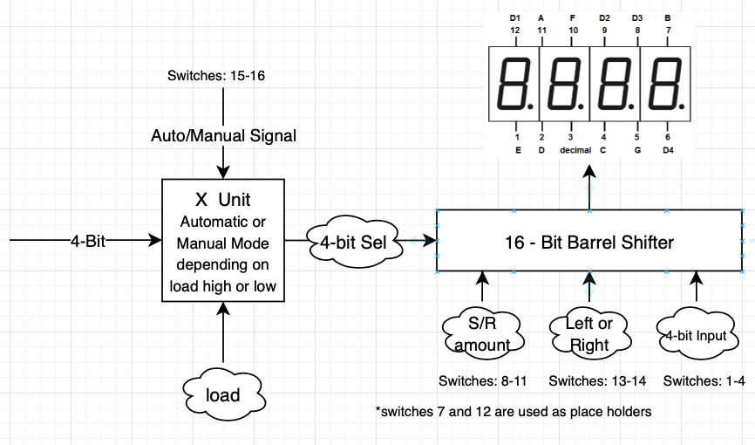
Design Process Flowchart

Slide 6
Shifting Process
Left Shift
Right Shift
Most-significant bit is lost
“0” bit inserted on opposite end
Single shift doubles original binary number
0010 → x1 shift → 0100
0010 → x2 shift → 1000
Least-significant bit is lost
“0” bit inserted on opposite end
Single shift halves original binary number
1011 → x1shift → 0101
1011→ x2 shift → 0010

Slide 7
Rotating Process
Left Rotation
Right Rotation
Binary value is initially shifted left by desired amount (switches 8-11)
Shifted value stored in register
Binary value is shifted right and stored in register
Shift = total bits - rotated bits
Initial shift right by desired amount (switches 8-11)
Store in register
Shift left (difference between total and rotated bits)
Store in register

Slide 8
Example: n = 229 = (11100101)₂
Left Rotate by 3 bits
Right Rotate by 3 bits
Switch positions of first 3 MSBs to LSB location
Switch positions of first 3 LSBs to MSB location
A = n << 3 | 00101000
B = n >> 5 | 00000111
Answer = A | B | 00101111
A = n >> 3 | 00011100
B = n << 5 | 10100000
Answer = A | B | 10111100

Slide 9
Barrel Shifter Modes
Load
Switches 15-16:
Manual or Automatic Mode
Low = no load
High = load
Was interpreted as:
No load takes the settings from the inputs and ignores the counter
With load the shift/rotate amounts are ignored
Automatic/Manual
Low = Manual mode
High = Automatic mode

Slide 10
Seven Segment Display
Single display represents up to 4 bits
In total we can display 16 bits from switches
Numbers displayed are changed based on the bits being rotated or shifted

Slide 11
Testbench
Tried simulating all corner cases for the input of the barrel shifter.

Slide 12
Conclusion
This lab required a lot of knowledge from our previous labs
Shifting, registers, timing, seven segment display, etc.
We faced challenges in our design process
Needed to implement creativity and concepts from prior experiments to tackle problems
We managed to get everything to work for the lab, except the testbench.

